Slide 1
Повнота метаданих
Покращення участі журналів

Slide 2
Crossref робить результати досліджень видимими, цитованими,
доступними та готовими для повторного використання
Ми є неприбутковою організацією, мета існування якої –
покращити наукову комунікацію
Notes:
Our members register their outputs with us and maintain and update metadata long-term, telling us if content moves to a new website, and they include more information as time goes on. This means that there is a growing chance that content is found, cited, linked to, included in assessment, and used by other researchers.

Slide 3
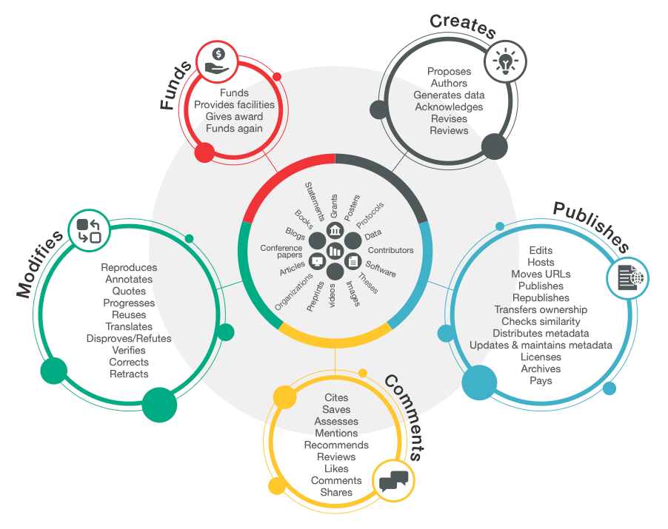
Research Nexus vision
Notes:
the Research Nexus—a rich and reusable open network of relationships connecting research organizations, people, things, and actions; it is a scholarly record that the global community can build on for the benefit of society
The value of Crossref doesn’t come from just the DOI or just the metadata, but in how that metadata captures the connections between authors, funding, funders, research institutions, publications and other research outputs.
At Crossref we make our metadata (plus all their connections and relationships) visible and trackable through our open metadata and APIs.
However, as we move toward realizing this vision of a connected Research Nexus, building a network FOR the global community must include input FROM ALL of the global community.

Slide 4
Crossref огляд
20,000 членів та афіляцій
148 держав
144 млн записів
600 млн запитів/місяць
Один млн DOI звернень/місяць
Notes:
Crossref is a membership organization and membership is open to organizations that produce professional and scholarly materials and content. We work with a diverse group of members and affiliated organizations, with now over 20,000 member and affiliated organizations from 148 countries.
Our members include research institutions, commercial publishers, universities, libraries, funders etc.To date, our members have registered metadata for over 144 million content items with us. These include journals articles, books and chapters, reports, standards and grants, to name just a few.
We offer a wide array of services to ensure that scholarly research metadata is registered, linked, and distributed. When members register their content with us, they assign it a DOI and we collect metadata about that piece of content. We process this metadata so that connections can be made between publications, people, organizations, and other associated outputs.
We preserve the metadata we receive for the scholarly record and make it openly available across a range of interfaces and formats so that the community can use it and build tools with it.

Slide 5
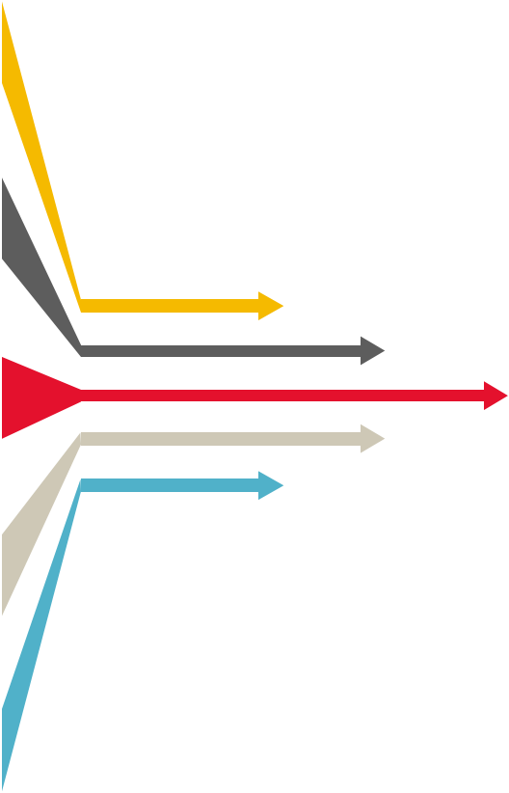
Members —> Crossref
Базові метадані: назва; ім’я автора; ISSNs/ISBNs, анотація, посилання
Інформація щодо фінансування: ідентифікатори
Афіляції: ORCID, ROR
Інформація щодо ліцензій: License URLs
Повні тексти URL-адреси: наприклад, для Similarity Check
Crossmark: оновлення, правки,
ORCID ідентифікатори
Recently: Peer Review звіти, зв'язки, посилання на пов'язані метадані, ідентифікатори грантів
Notes:
There are many types of content that can be registered with Crossref. Most people know that DOIs are used for journal articles, but Crossref accepts many other types of content and we’re constantly expanding that pool, in line with the changing needs of the community. Still approximately (75%) percent of our content is journal articles, followed by 15% of books. Our newest type is grants, which while still small, is a fast growing area as more funders join Crossref.
When registering their published content, members supply us with a wide range of metadata including but not limited to those you can see on the slide). In the context of Crossref, metadata is information about publications which we then make available for thousands of other parties to use in the tools and services they provide. The metadata will vary based on the type of content that is being registered.
Basic metadata requirements include things like titles, authors, publication dates, issue numbers, ISSN, ISBN - anything that describes the content you’re registering. We also collect non-bibliographic data about the items being registered. This can include reference lists, funding data, ORCIDs, license data, clinical trial information, abstracts, and data about relationships between items. Information on errata, retractions, updates and more can be registered through our Crossmark service.
We ask our members to send us as much metadata as possible, and that it be accurate and clean – the more comprehensive your metadata is, the more likely your content will be discovered and disseminated. We strongly encourage members to update their records whenever more information becomes available – to add it to their records.

Slide 6
Метадані забезпечують:
Пошукову доступність
Відтворюваність
Цілісність досліджень та редакційної діяльності
Звітність та оцінку.
Notes:
The more metadata you include about a piece of content, the easier it is for others to search and discover, from researchers to organisations who use Crossref to build their own tools and services for the research community. A few example of how: Our books metadata project has shown that books with basic metadata are more likely to come up in searches in Google Scholar. Journal articles with deposited references seem to be cited more than those without, and by a lot: 21.8 vs. 6.1 incoming citations on average
Reproducibility is also critical. Researchers need to be able to build upon each others' work. Verifying and reproducing the results from earlier work is helped by metadata such as links to funding, protocols, research data, and peer review reports help to create a complete picture of a work.
In addition to using metadata for discovery, metadata also helps determine the integrity of the research - who funded the research, what are the affiliations of the authors. Could there be conflicts of interest?
Reporting and assessment may be carried out by a variety of organizations, including universities and funders in order to: show the accountability and benefits of public investment, provide benchmarking information, demonstrate compliance with funder mandates, and, decide what research to fund. Including metadata such as affiliation (ROR) identifiers, ORCIDs, funding and grant information, license URLs, peer review reports and links to preprints all help with this.

Slide 7
Notes:
Why registering comprehensive metadata is important? Well, it’s because many organizations use that metadata to find that published content. Because Crossref’s metadata is standardized and machine readable it is very useful to many organizations that make that content more discoverable, through their tools and services such as author profiling tools, manuscript tracking systems, library discovery services, metrics providers and more.

Slide 8
Як можна покращити метадані?
Notes:
First of all – it’s best to identify areas of strength and those of improvement. Then, it may also be useful to learn what and how others are doing well.

Slide 9
Звіт про участь
Звіт про участь дозволяє учасникам побачити узагальнену інформацію щодо метаданих, які вони реєструють у Crossref та їх якість.
https://www.crossref.org/members/prep
Notes:
Why is this important? Crossref members:
Not always aware of what metadata they’re sending to Crossref
Can see what’s missing and can fix the gaps
Can track progress of their metadata in an easy and user-friendly way

Slide 10
Чи використовували ви колись звіт про участь?
Якщо так, підійміть руку

Slide 11
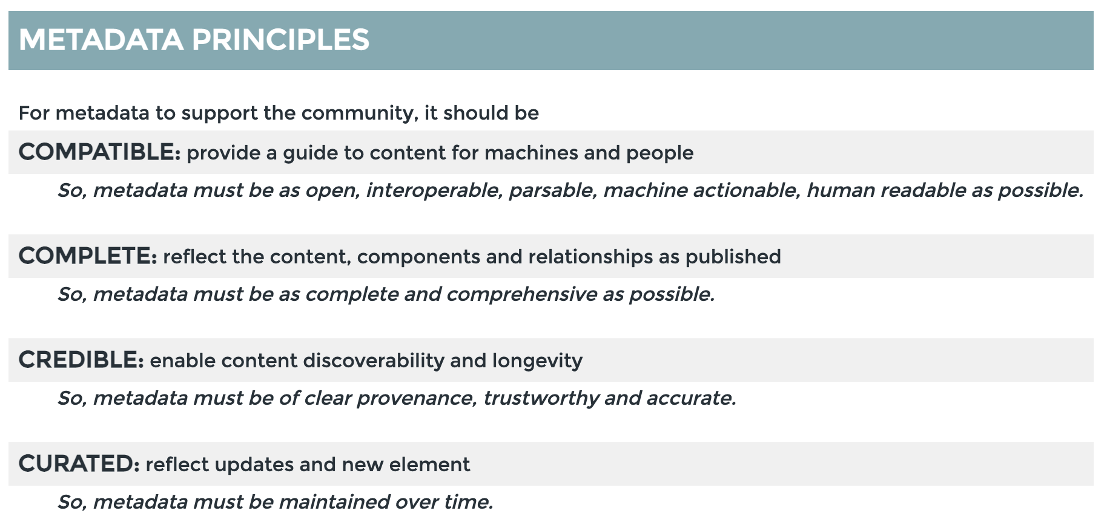
Метадані повинні бути..
сумісні
повні
достовірні
організовані
Source: https://metadata2020.org/resources/metadata-principles/
Notes:
For scholarly metadata to be useful, there are some recommendations – or principles – that data needs to meet.
It needs to be compatible for different types of users (human or machines alike), complete, credible and curated.
Participation reports help organisations monitor the completeness of their metadata.

Slide 12
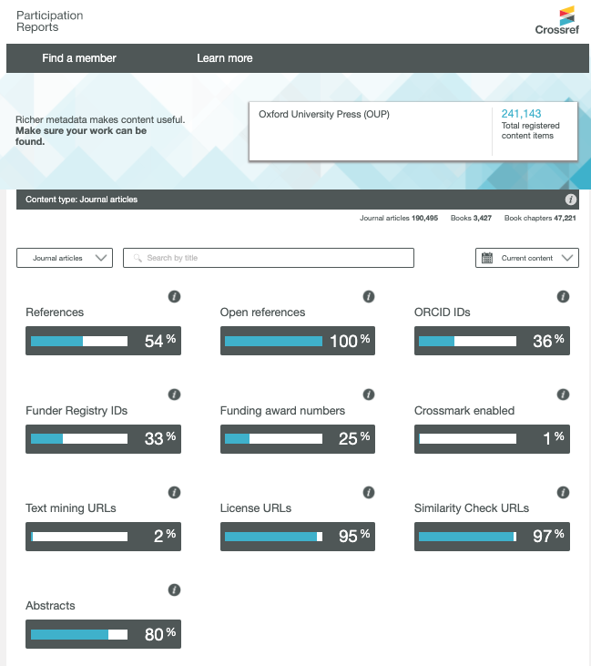
Notes:
Current content screen shot of OUP (update here: https://www.crossref.org/members/prep/286) in place of live demo if preferred - you can select a different member more relevant to your audience if need be.
Here’s what an example participation report looks like. Let’s now try and make a quick live demonstration. Please follow the link in the chat https://www.crossref.org/members/prep
Explain: current content/ compared with all time and backfile
Some priority metadata elements we recommend for all content whenever relevant
I encourage you all to have a go and try it out yourselves with your favorite Crossref members

Slide 13
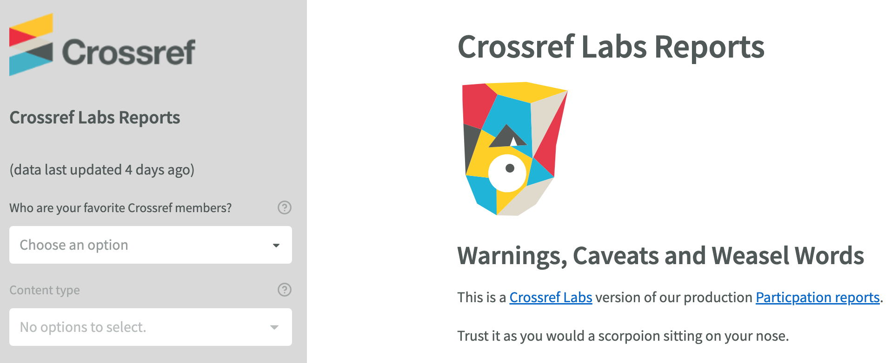
Незабаром….
https://www.crossref.org/members/prep
Notes:
Before I’m finished I wanted to highlight that we’re working on a new version of the reports already. The test version is available now. It includes more metadata elements, as well as other functionality that our current reports don’t provide.
My colleague, Paul Davis, works on this project and is with me today. He has recently offered a walk through demo of this test report
[Demo briefly if time, share the link if not]

Slide 14
Other services based on your metadata
Notes:
With the basics out of the way, I wanted to share some of the digital tools we have on offer for scientific journals, indeed for all Crossref members, that allow the community to take advantage of rich metadata in different ways.
Reference linking
Cited-by
Crossmark

Slide 15
Посилання на список використаних джерел
Посилання на список використаних джерел дозволяє дослідникам переходити за посиланням із списку літератури до інших документів у повному тексті, допомагаючи їм знаходити зв'язки.
https://www.crossref.org/services/reference-linking/
Notes:
Reference linking means including Crossref DOIs (displayed as URLs) when you create your citation list. This enables researchers to follow a link from a reference list to other full-text documents, helping them to make connections and discover new things. And because it’s a DOI rather than just a link, it will remain persistent.

Slide 16
Cited-by
Cited-by надає огляд публікацій, які цитують певний контент, допомагаючи сформувати уявлення про те, як дослідження було сприйнято спільнотою.
https://www.crossref.org/services/cited-by/
Notes:
Researchers cite the work of other people to support the material they have used when writing their articles. It helps to be able to see which articles are citing an article that you are reading and how they researchers continued to develop their ideas. This is the main function of Cited-by: show the number of citations and link to the publications that cite the article.
Cited-by allows members to show authors and readers that other Crossref content has cited their content. Request this information from Crossref and then display it on your website in whatever format you like.

Slide 17
Crossmark
Crossmark забезпечує спосіб перехресного доступу для читачів, щоб швидко дізнатися про статус результатів дослідження, а також додаткові метадані, пов'язані з редакційним процесом.
https://www.crossref.org/services/crossmark/
Notes:
Research doesn’t stand still: even after publication, articles can be updated with supplementary data or corrections. It’s important to know if the content being cited has been updated, corrected, or retracted. Crossmark makes this information more visible to readers. With one click, you can see if content has changed, and access valuable additional metadata provided by the member, such as key publication dates (submission, revision, acceptance), plagiarism screening status, and information about licenses, handling editors, and peer review.
Crossmark lets readers know when a substantial change affecting the citation or interpretation has occurred, and that the member has updated the metadata record to reflect the new status.

Slide 18
Документація: https://www.crossref.org/documentation/
Email support@crossref.org
Форум: https://community.crossref.org
Вебінари та заходи: https://www.crossref.org/events/
Notes:
If you need any further help and information you can refer to our support Documentation (available in English) at the page on the slide, if you have a specific technical question you can email our support team at support@crossref.org and we will get back to you there. We encourage you to also check out our community forum where you can also post questions to the group, in English or any other language. We also have a page about upcoming webinars as well as where you can find all our recordings from previous events.

